Slide 1
Anti-Bullying Week 2019: Change Starts With Us
Primary School Assembly PowerPoint

Slide 2
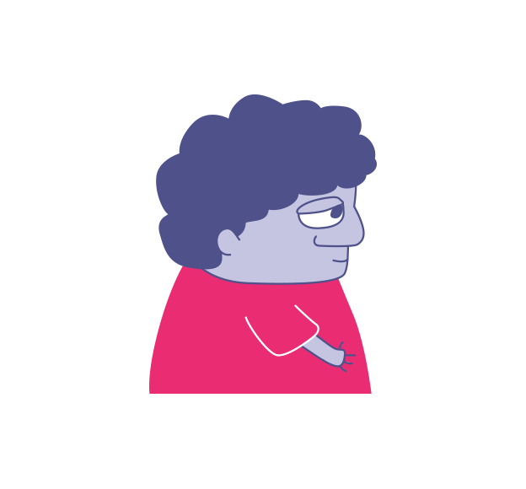
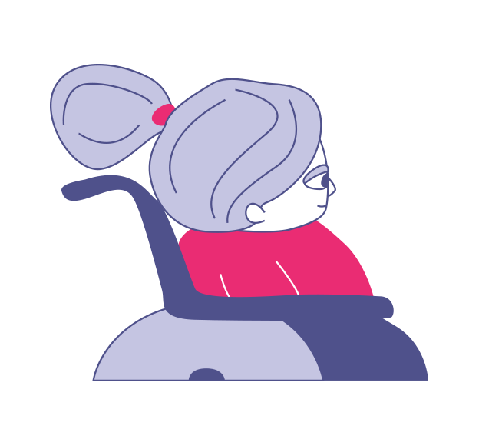

When was the last time somebody…
asked how you are?
gave you a compliment?
included you?
smiled at you?
helped you out?
Pair share
When was the last time these things happened to you? How did it make you feel?
Discuss
What would school be like if no one did these things?

Slide 3
Be the change you want to see…
“Are you OK?”
“Would you like to join in?”
“I thought you did really well!”
“You can sit with me!”
“How are you feeling?”
“Nice try!"
Discuss (2-3 mins)
Who is responsible for making sure these things are said?
“Did you have a nice break time?”
“Can I help you?”

Slide 4
It really is up to us to be the change and make our community (both online and face-to-face) a good place!

Slide 5

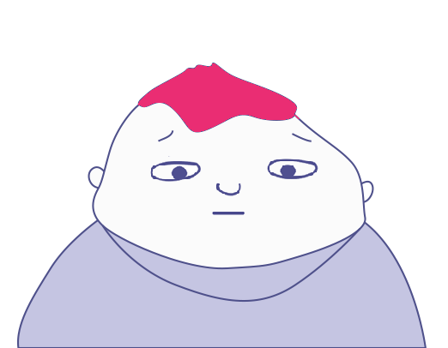

What would you change?
Dan went to a birthday party at the weekend. Saima took a video of Dan diving into the pool.
Saima said the video was funny but Dan didn’t like it. He asked her to delete it. She refused.
At school on Monday, Dan heard people talking and laughing about the video. Lots of pupils had seen it.
Dan’s friend Caitlyn showed him the video. Some pupils had written mean things underneath it.

Slide 6

What would you change?
Liam is handing out the Maths books. He sees something rude written on Ava’s book. He ignores this and hands it to her.
Ava looks at her book. “You’re stupid,” is written across the cover. Ava quickly rubs it out and doesn’t tell anyone.
The next day, the same thing happens. Some pupils on Ava’s table watch her rub it out. They start whispering.
At break time, Ava can hear people gossiping about the comments on her book. Some children are staring at her and pointing.

Slide 7
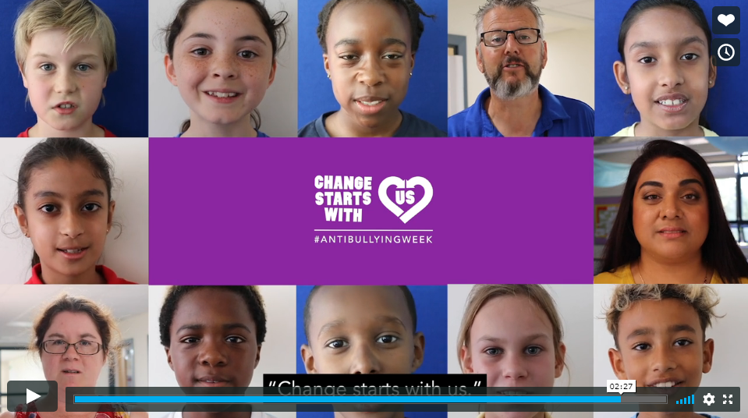
Change Starts With Us!
VIDEO LINK: https://youtu.be/fG8FhwiYTB0

Slide 8

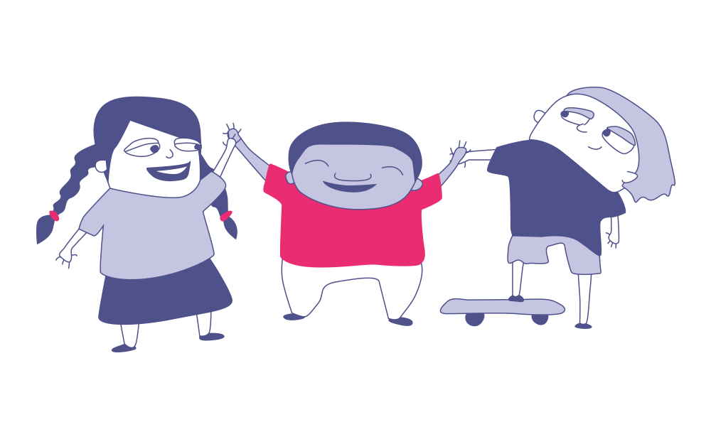
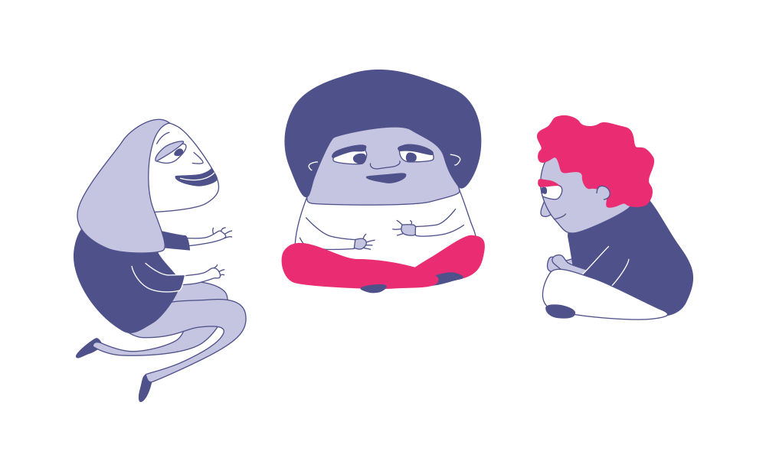
Change Starts With Us!
Your
opinion matters!
Bullying can be a problem both in schools and online. But it doesn’t have to be this way!
This week, we want you to make your voice heard on bullying!
In your classes, you will be discussing the question:
Do you think it is possible to reduce bullying in your school?
At the end of the lesson you will get to vote on this question and share your opinion with the nation.
We want to hear your ideas for how to make schools happier and safer for everyone. Maybe there is something you would like to change, or something you already do that others could learn from! Either way, we want to hear your ideas for reducing bullying.

Slide 9
Thanks for participating.
Notes:
Close the session and remind of the wider programme and the available resources.

