Slide 1
Anti-Bullying Week 2019: Change Starts With Us
Primary School Lesson PowerPoint

Slide 2

What is bullying?
The ABA (Anti-Bullying Alliance) defines bullying as:
The repetitive, intentional hurting of one person or group by another person or group, where the relationship involves an imbalance of power.
Bullying can be physical, verbal or psychological.
It can happen face-to-face or online.
Repetitive
Hurtful
Intentional
Power imbalance

Slide 3
Discuss (5 minutes)
Let’s start by thinking about what school already does to prevent and respond to bullying and make sure you feel happy and safe. How many things can you think of? Write a list.

Slide 4

Do you think it is possible to reduce bullying in your school?
The question we’re asking your opinion on today is: is change possible? Can you think of ways you could make your school better for everyone?

Slide 5
Change Starts With … Having a Voice!
We want to hear from you about whether there are any changes, big or small, that could make your school a better place and reduce bullying, because every child deserves to feel happy and safe.

Slide 6
We do everything we possibly can to try and prevent bullying. When it does happen we know what to do.
FRONT
We do a lot in school to make it a safe, happy place for everyone.
How good is your school at dealing with bullying?
LEFT
RIGHT
I think that we are far away from making school a safe and happy place and we could do a lot more to reduce bullying.
I think there is more that we could do at school to reduce bullying and respond to it better.
BACK

Slide 7
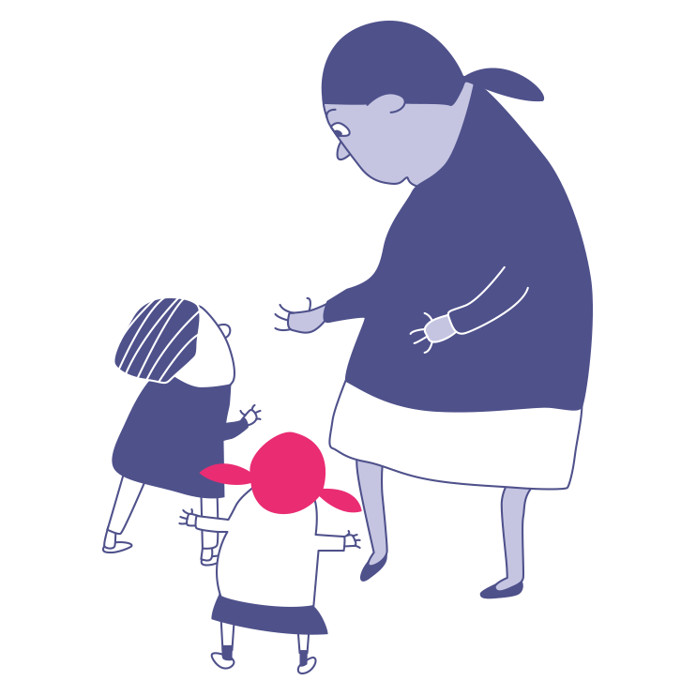
Who are the people in school that can help us to reduce and respond to bullying?

Slide 8
Change starts with … collective activity
 | Preventing bullying | Responding to bullying
In school
Online

Slide 9
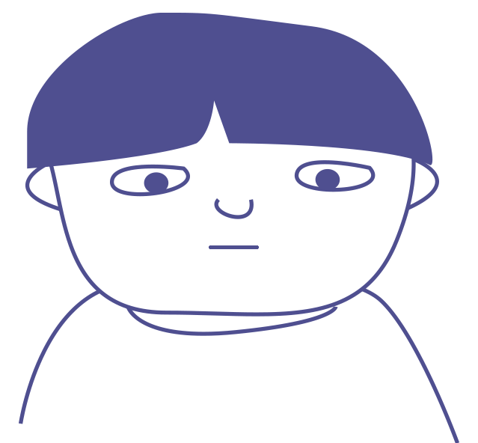
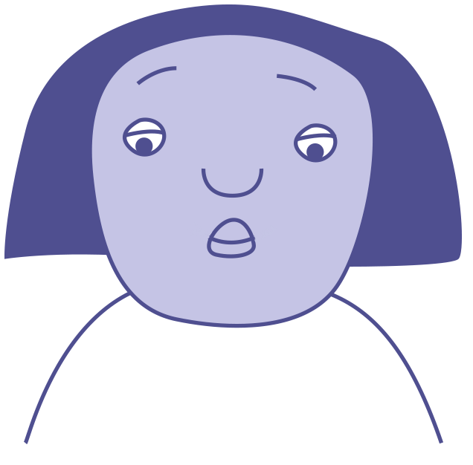

Change starts with…?
What could you do?
Max is not himself today. He has hardly said a word.
Smile
Compliment them
Laugh
Find an adult
Jasmine is sitting on her own at lunch. She looks lonely.
Sit with them
Walk away
Ask if they are OK
Invite them to join
You hear snuffles coming from one of the toilets. It sounds like crying.
Ignore them
Ask if you can help

Slide 10
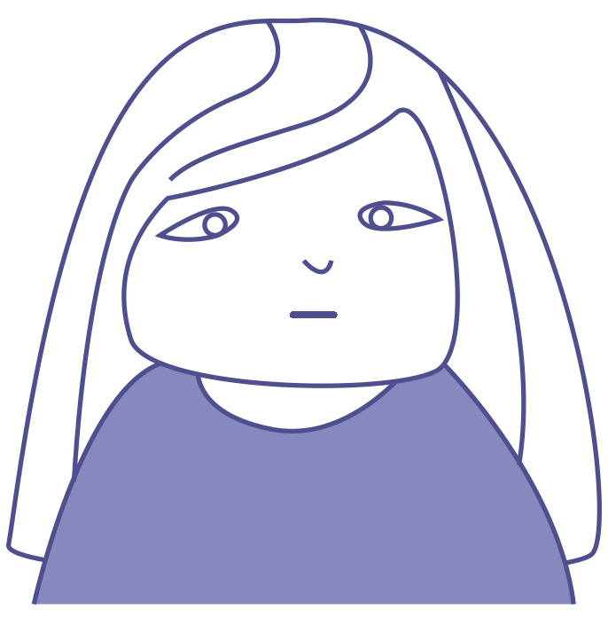
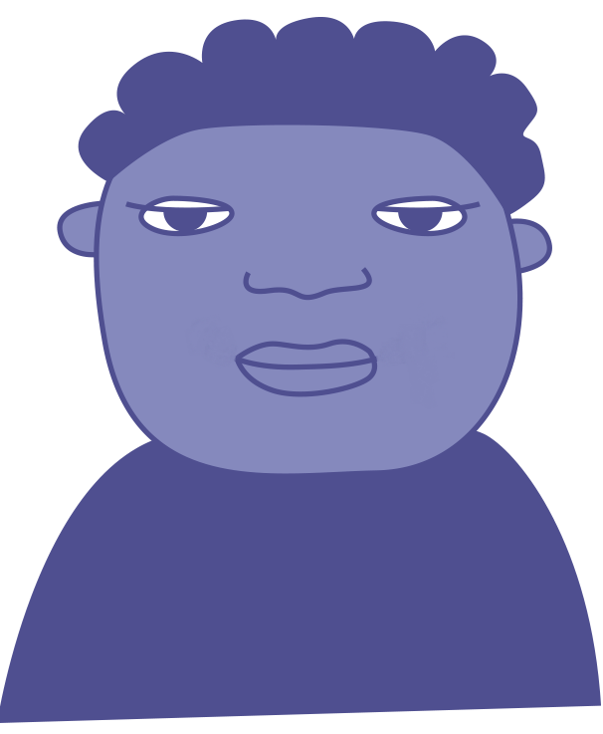
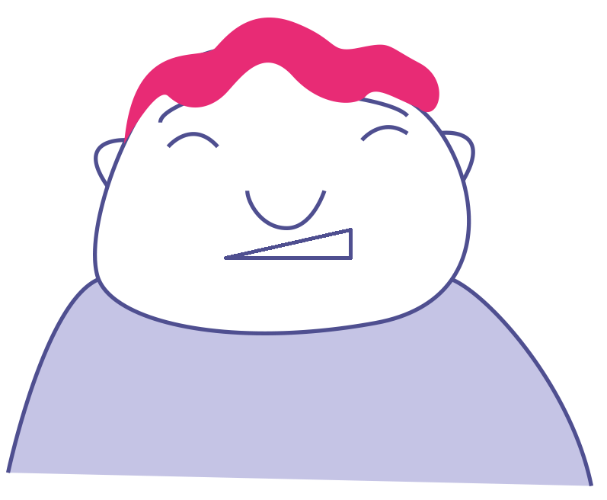
Change starts with? …
What could you do?
Faiza is reading a message on her phone. She looks worried.
Smile
Compliment them
Laugh
Find an adult
You hear someone saying something nasty to Grace in the playground.
Sit with them
Walk away
Ask if they are OK
Invite them to join
A pupil from another class is wandering around with no one to play with.
Ignore them
Ask if you can help

Slide 11
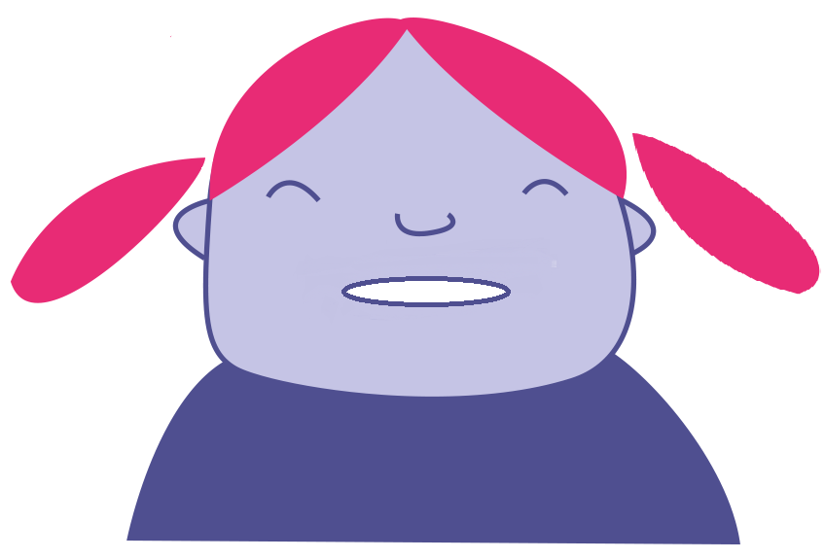
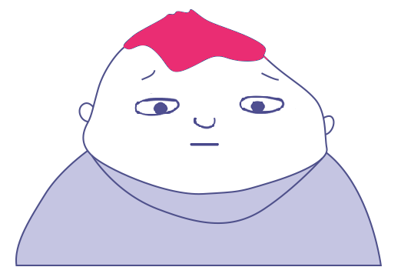
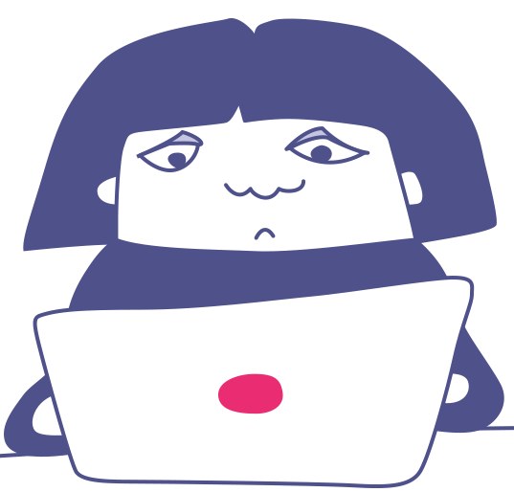
Change starts with? …
What could you do?
You see your friend push someone & say, ‘You can’t play with us’ to another pupil.
Smile
Compliment them
Laugh
Find an adult
Someone makes a joke about Isaac. He doesn’t laugh and looks upset.
Sit with them
Walk away
Ask if they are OK
Invite them to join
Someone sends a mean message to you about a person in your class.
Ignore them
Ask if you can help

Slide 12
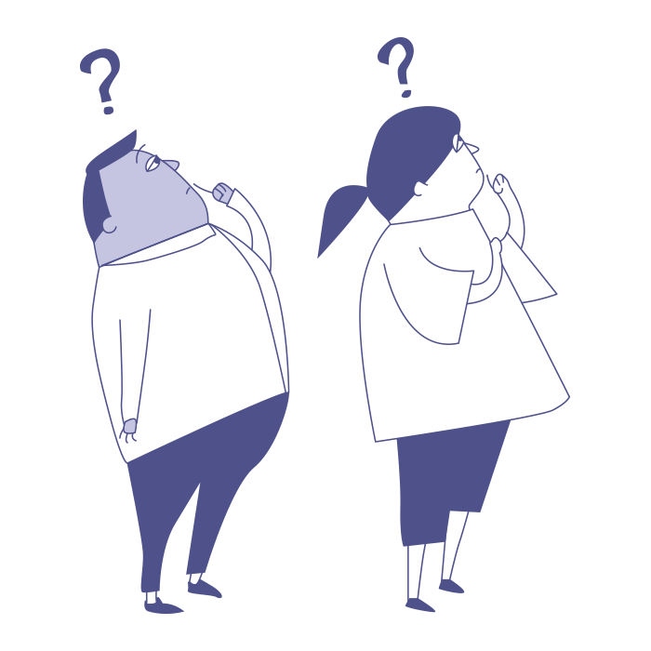
Do you think it is possible to reduce bullying in your school?

Slide 13

Change starts with … You!
Bullying is a big issue and can be scary to deal with, but by making small, simple changes we can all make sure our school is a safe, happy place for everyone.
Individual activity: Think about a change you could make which would make your school an even better place, a place where bullying doesn’t happen.
Write it in a Change Starts With Us heart pledge.
So what are you waiting for?!
What change are you going to make today and every day to help challenge bullying?

Slide 14
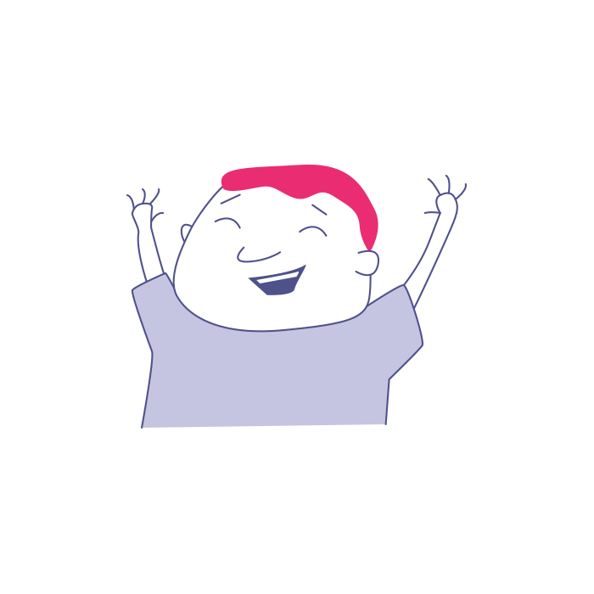
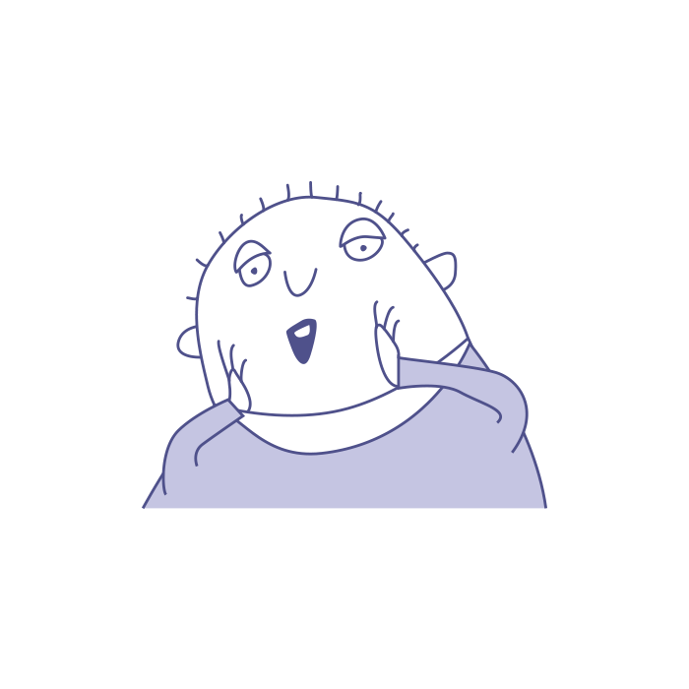
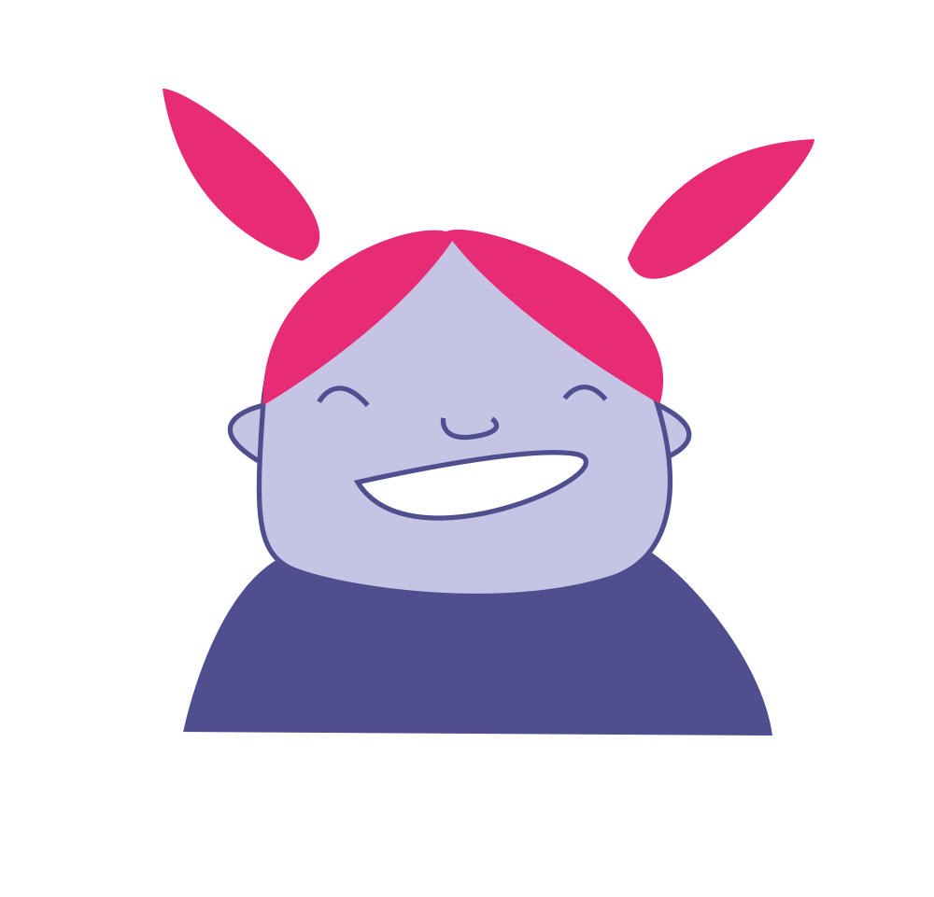
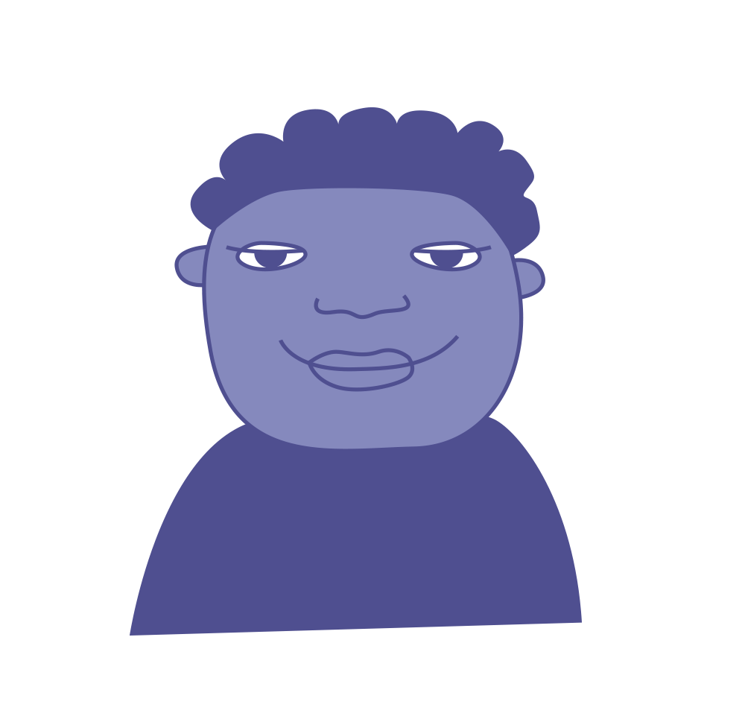
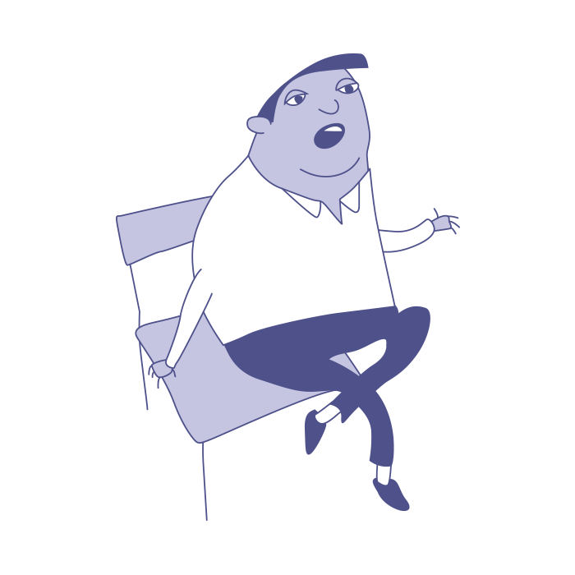
Pledge ideas
“…choosing not to share things that could upset someone else.”
“…looking out for children who look lonely at lunch.”
“... asking pupils how their lunch break has been every day!”
“…inviting people to join in even if they aren’t my friends.”
“… making sure my friends always know they can talk to me.”

Slide 15
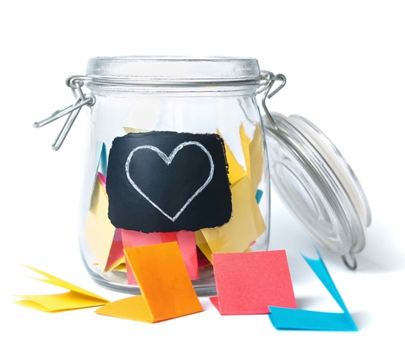
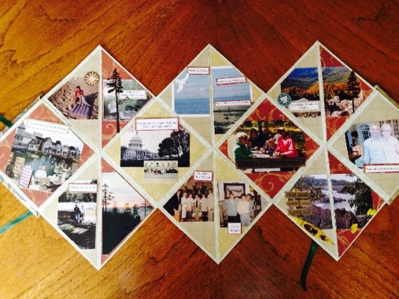
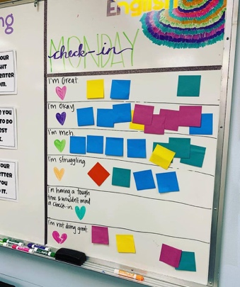
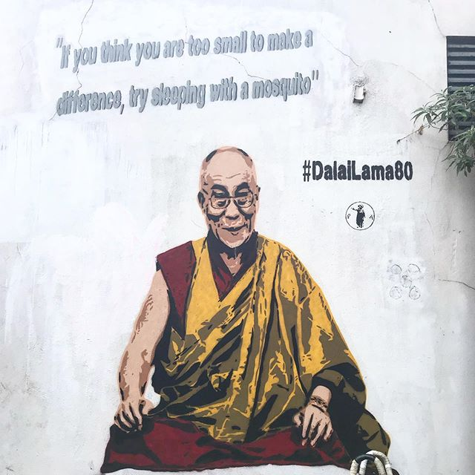
Change starts with … Us!
Start a jar full of small changes
Make exploding books!
Create a check-in wall
Make an Inspiration wall
Is there something we could put in our classroom to encourage us to make changes to stop bullying?

Slide 16

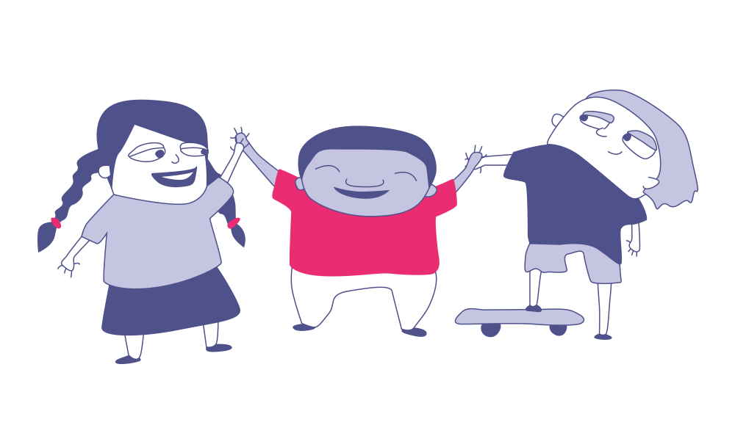
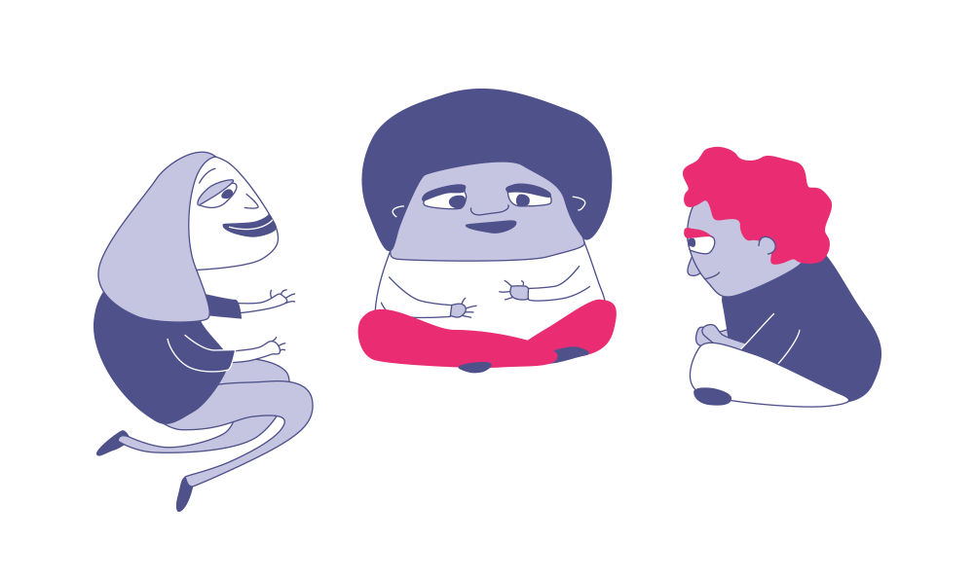
Change Starts With Us!
Your
opinion matters!
So, bullying can be a problem both in schools and online. But it doesn’t have to be this way!
This week, we want you to make your voice heard on bullying!
You have been discussing the question:
Do you think it is possible to reduce bullying in your school?
Now it’s time to vote this question and share your opinion with the nation.
We want to hear your ideas for how to make schools happier and safer for everyone. Maybe there is something you would like to change, or something you already do that others could learn from! Either way, we want to hear your ideas for reducing bullying.

Slide 17
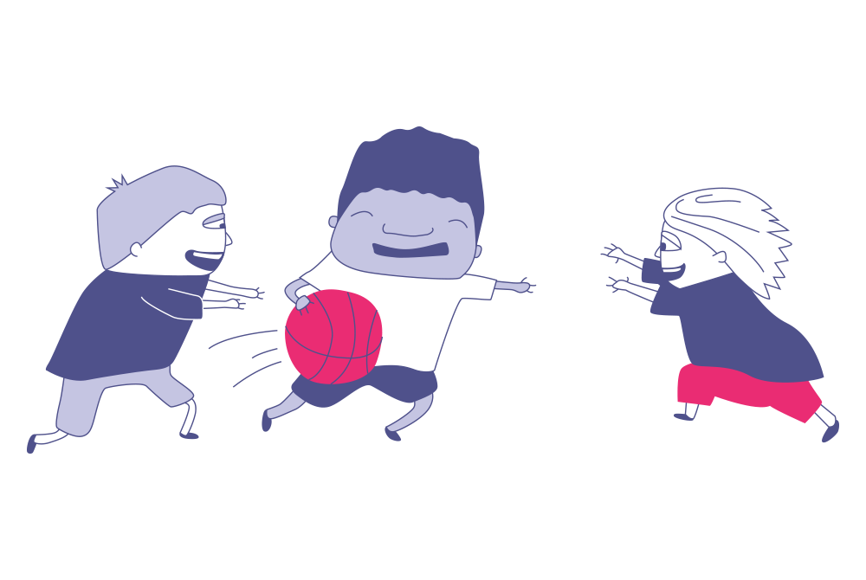
Make your vote count:“Do you think it is possible to reduce bullying in your school?”

Slide 18
Do you think it is possible to reduce bullying in your school?
The debate …
Yes
No
Until bullying ends once and for all, there must be more we can do.
There is always room for improvement.
Even small changes like smiling at someone, can make a big difference.
It is everyone’s responsibility to reduce bullying, not just teacher’s.
At our school, everyone does their best to do small things like be kind, helpful and include others.
We have great systems to stop bullying at school.
We don't have any bullying here.
It is not my responsibility to reduce bullying.

Slide 19
Thanks for participating.
Notes:
Close the session and remind of the wider programme and the available resources.

