Slide 1
Anti-Bullying Week 2019: Change Starts With Us Secondary School Assembly Plan – ppt

Slide 2
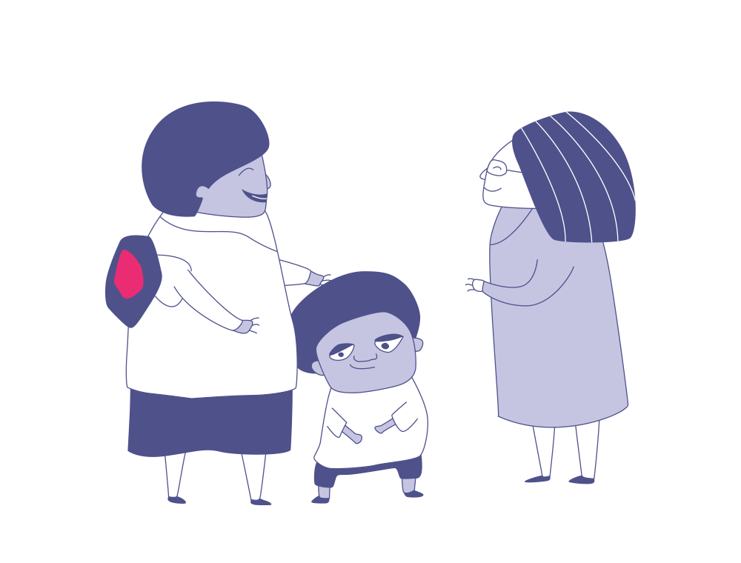
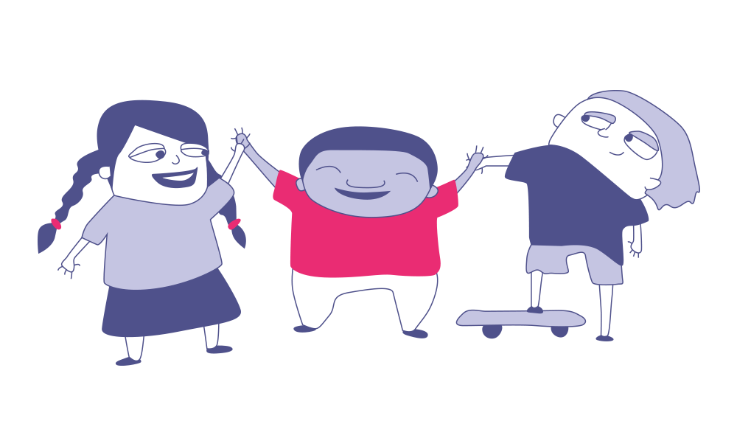
Change starts with …?
Who is most responsible for tackling bullying?
1
3
Students?
Your
teachers?
Who currently does the most to tackle bullying?
Who could do more to tackle bullying?
2
4
The school?
Parents and carers?
Hold up the number of fingers (1-5) to show your answers to each question!

Slide 3
Do you think it is possible to reduce bullying in your school?
We want to hear from you!

Slide 4
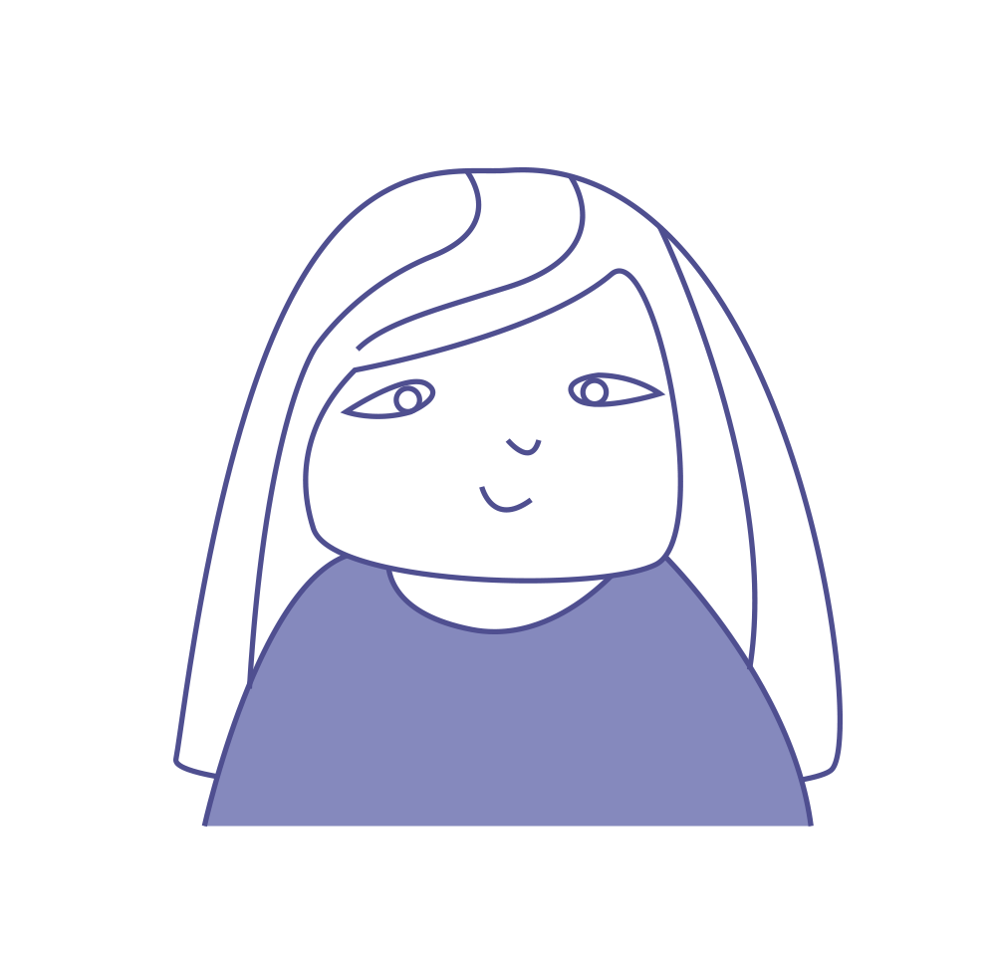
Change starts with … having a voice
Bullying is still a big problem in the world today. It affects us both in our schools and online; many of us will be affected by it in some way. Something needs to change. But what?
The question we’re asking you today is about whether change is possible. As a school, can we work together to make the world better for the people around us?

Slide 5
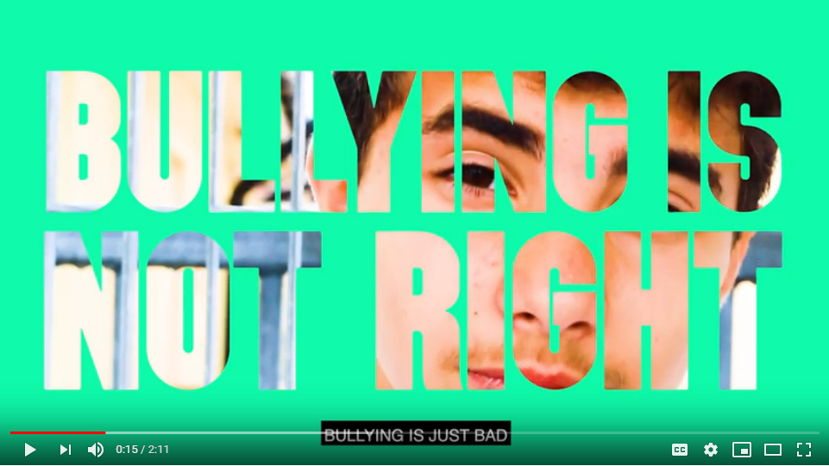
Change Starts With Us!
VIDEO LINK: https://youtu.be/oAmVkVEmOP4

Slide 6
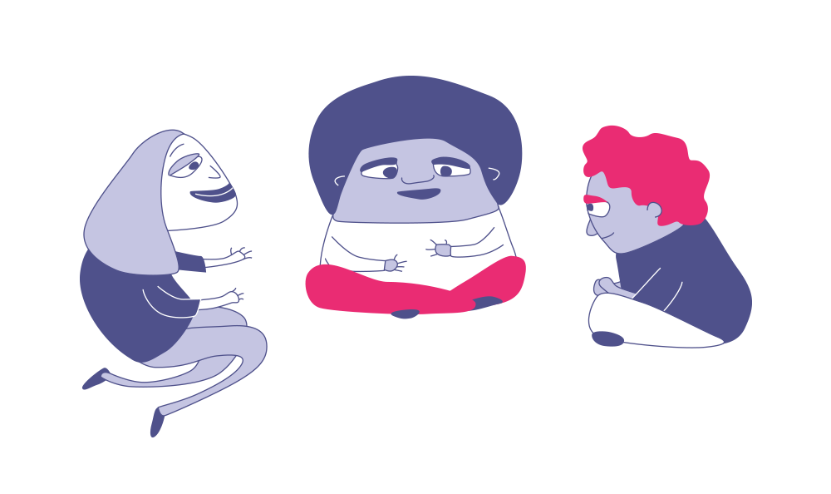
Change Starts With Us!
Your opinion matters!
Bullying can be a problem both in schools and online. But it doesn’t have to be this way!
This week, we want you to make your voice heard on bullying!
In your classes, you will be discussing the question:
Do you think it is possible to reduce bullying in your school?
At the end of the lesson you will get to vote on this question and share your opinion with the nation.
We want to hear your ideas for how to make schools happier and safer for everyone. Maybe there is something you would like to change, or something you already do that others could learn from! Either way, we want to hear your ideas for reducing bullying.

Slide 7
Thanks for participating.
Notes:
Close the session and remind of the wider programme and the available resources.

