Slide 1
Anti-Bullying Week 2019: Change Starts With Us
Secondary School Lesson PowerPoint

Slide 2
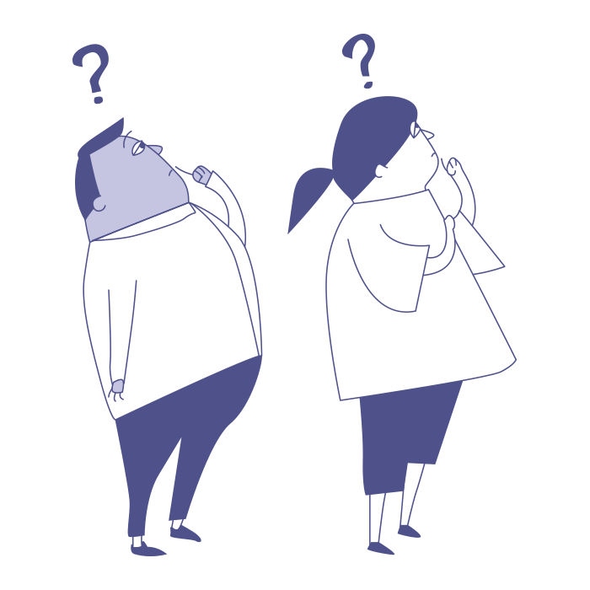

Starter: Design your perfect school
Rules and consequences?
Pair task (10 mins)
Imagine you get to design your perfect school / social media platform. It is a positive, happy and safe place for everyone.
Breaktimes?
Support for wellbeing?
Uniform?
Subjects and lessons?
Mobile phones?
Lunches?

Slide 3

Do you think it is possible to reduce bullying in your school?
It might be that you feel your school does enough. It might be that you feel more could be done to reduce bullying. Today is your chance to have a say and share your ideas for changes, big or small, that could make a difference to bullying.

Slide 4
Learning objectives and key words
To discuss how we could reduce bullying
To discuss how we can respond to it quickly and effectively when it does happen
To evaluate whether small changes can make a big difference
Bullying: The repetitive, intentional hurting of one person or group by another person or group, where the relationship involves an imbalance of power.
Banter: the playful and friendly exchange of teasing remarks.
Barrier: Anything that prevents something from happening.

Slide 5
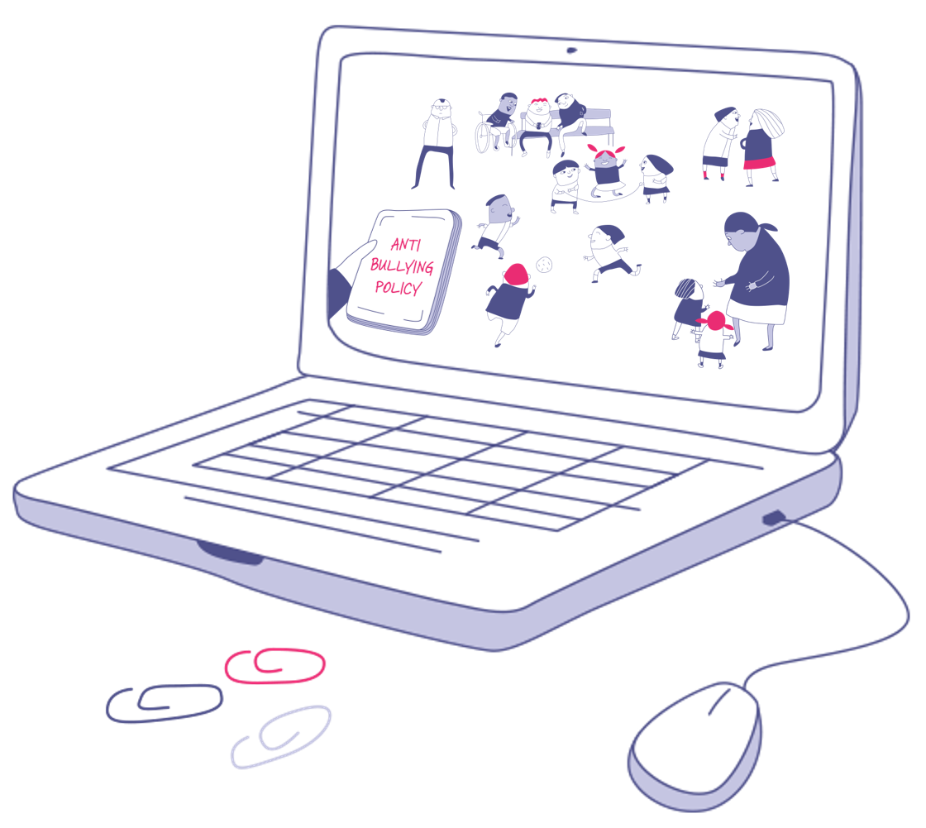
Learning journey
Design your perfect school
Change starts with … honesty
Change starts with … speaking out
Change starts with … small actions
Change starts with … addressing the problem
Change starts with … us!
Vote: make your voice heard

Slide 6
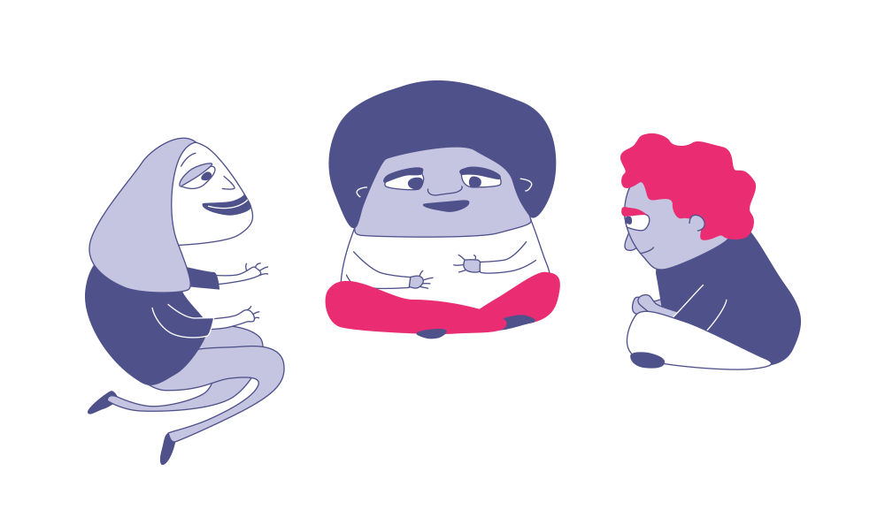
Change starts with … honesty
Silent reflection task: Read the nine boxes on the next slide. If you are being completely honest with yourself, how many of these things have you done? You don’t have to share this with anyone.
Calculate the number in your head. It should be between zero and nine. We won’t ask people to share their number. Ask yourself, ‘what do you think is the number for the whole class?’ and ‘are you proud of this number?’

Slide 7
Change starts with … honesty
Laughed about a joke made at someone else’s expense.
Ignored a cruel comment on social media.
Called something ‘banter’ or ‘a joke’ when you knew it was mean.
Given another student an unfriendly look.
Liked / shared something you are not proud of.
Ignored someone sitting on their own.
Left someone out on purpose.
Wound someone up intentionally.
Pretended not to notice someone was upset.

Slide 8
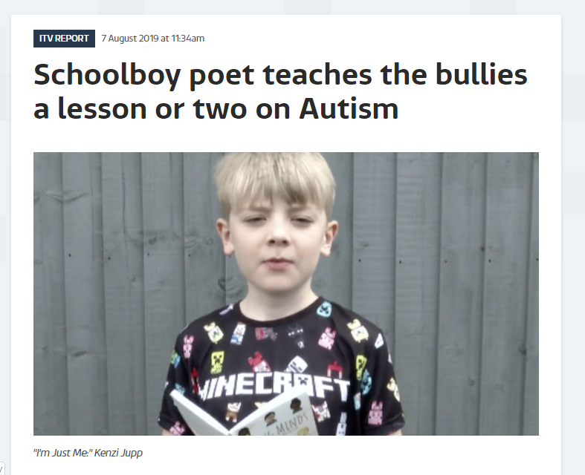
Kenzi’s story

Slide 9
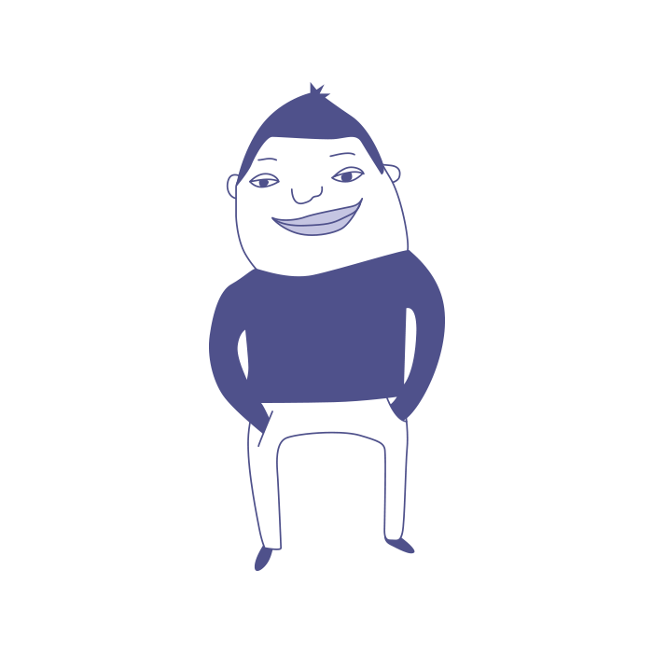
Sam’s story
Sam has just started at a new secondary school. He is quite a shy person and is just starting to make friends.
At breaktime, two older pupils called Aisha and Harry come over to talk to him when he’s alone.
They are chatty and friendly at first. Then they start leaning on his shoulder and saying: ‘You’re the perfect height for an arm rest!’
Sometimes around school, Aisha and Harry pretend not to see Sam, before tripping him up as they walk by. They laugh and say, ‘You’re so small I didn’t see you there!'
One day, Sam tells them they are making him uncomfortable. ‘Oh chill out, shorty! It’s just a bit of banter!’ Aisha says.

Slide 10
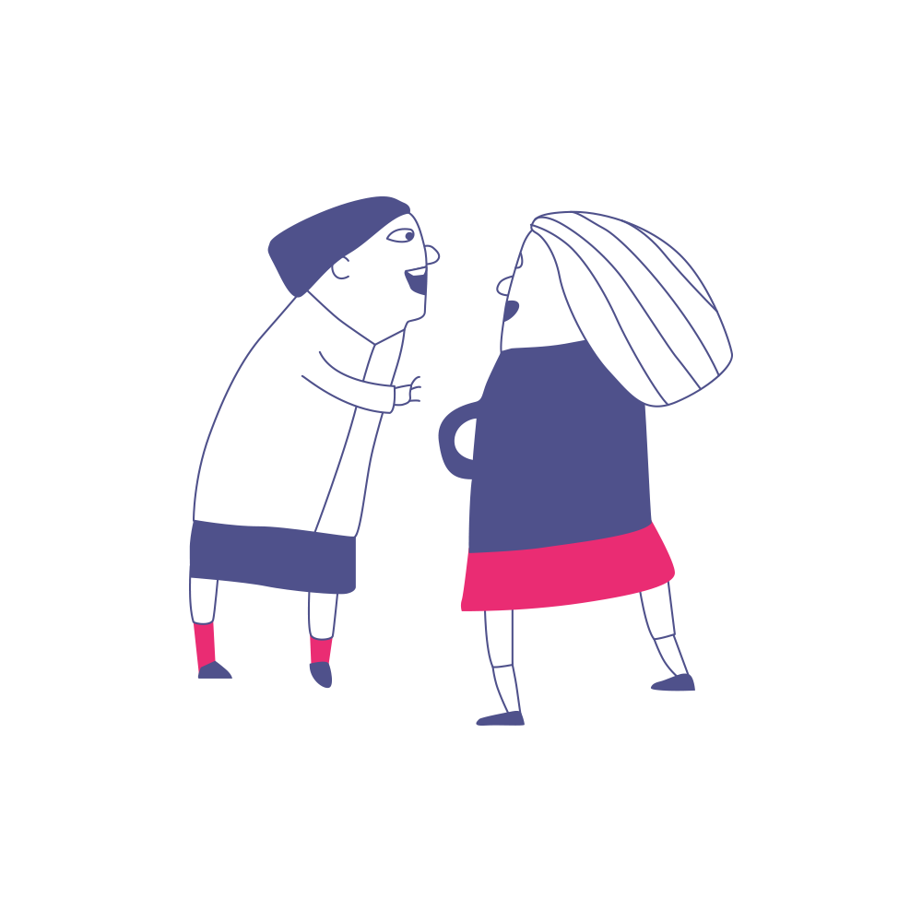
Maya’s story
Maya, Tash and Simrin have been close friends for years. Maya hurt her eye and is wearing an eye patch.
When Tash sees her, she starts laughing. ‘You look like a pirate.’ It upsets Maya. ‘Sorry, I was just joking,’ Tash says.
The next week, Simrin sneaks a pirate’s hat on Maya’s head and Tash quickly snaps a photo and posts it on Snapchat.
‘Delete that, now!’ Maya says furiously. Simrin laughs: ‘It’s gone Maya - Snapchat doesn’t keep photos, don’t worry!’
Later that week, Maya learns that Tash had edited the picture and sent it round different WhatsApp groups.
People at school start sharing the photo, laughing at her and shouting, ‘Maya the Pirate’ in the corridors.

Slide 11
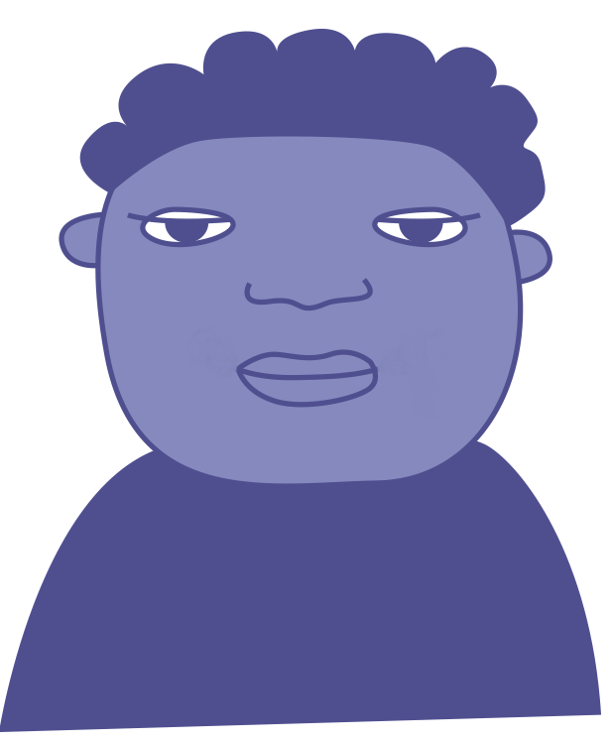
Freddie’s story
One night, while on Instagram, Freddie sees a link to a page with his name on it in a friend’s story. He clicks on it.
Freddie can’t believe what he sees: posts of pupils talking about how ‘annoying’ he is and how they don’t like him.
Some posts are screenshots of WhatsApps with his friends. His comments are circled. People are making fun of them.
There are photos of him in the library at school – photos he didn’t know were taken – with nasty comments.
The page has over a hundred followers. Several are people he considers to be friends.
He messages a friend about it, who immediately goes offline. Ten minutes later, the page has been deleted.

Slide 12
Change starts with … addressing the problem
Reflect:
What are the problems in your school when it comes to pupils being mean to one another?
Note: If you don’t have any problems like this in school, talk about what is already in place to make sure these things don’t happen.
Gossip & rumours?
Leaving out?
Online?
False friendships?
Jokes & ‘banter’?
Humiliation?
Fights?
Something else?

Slide 13
Change starts with … addressing the problem
Barriers | What can the school do? | What can students do?

Slide 14

Everybody can make a difference to bullying, no matter how big or small. So what are we waiting for?! What change are you going to make today and every day to help challenge bullying?
To be the change, I am going to ……….
………………………………………………….
#ChangeStartsWithUs #AntiBullyingWeek
Change starts with …………………………
………….………………………………………
#ChangeStartsWithUs #AntiBullyingWeek

Slide 15

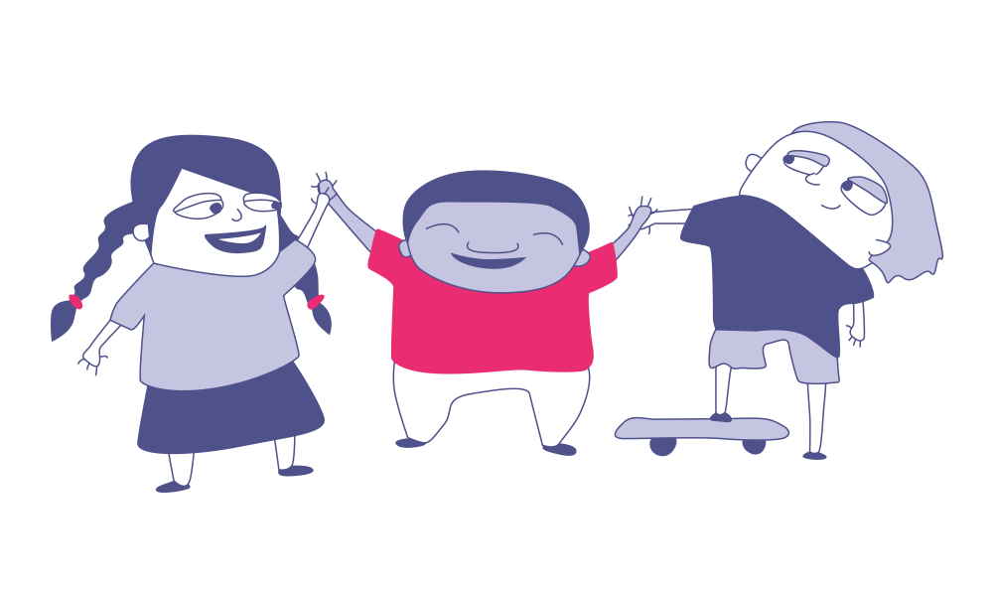
Change Starts With Us!
Your
opinion matters!
So, bullying can be a problem both in schools and online. But it doesn’t have to be this way!
This week, we want you to make your voice heard on bullying!
You have been discussing the question:
Do you think it is possible to reduce bullying in your school?
Now it’s time to vote this question and share your opinion with the nation.
We want to hear your ideas for how to make schools happier and safer for everyone. Maybe there is something you would like to change, or something you already do that others could learn from! Either way, we want to hear your ideas for reducing bullying.

Slide 16
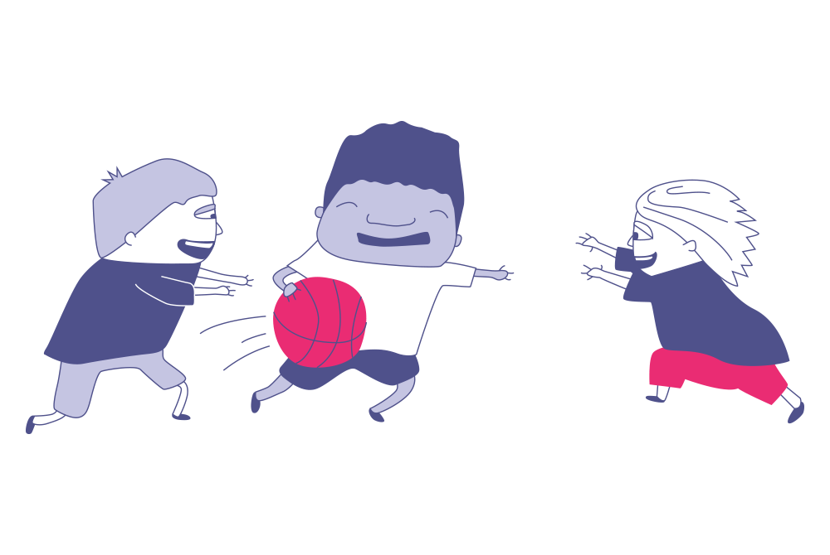
Make your vote count: “Do you think it is possible to reduce bullying in your school?”

Slide 17
Do you think it is possible to reduce bullying in your school?
The debate …
Yes
No
Until bullying ends once and for all, there must be more we can do.
There is always room for improvement.
Even small changes like smiling at someone, can make a big difference.
It is everyone’s responsibility to reduce bullying, not just teachers.
At our school, everyone does their best to do small things like be kind, helpful and include others.
We have great systems to stop bullying at school.
We don't have any bullying here.
It is not my responsibility to reduce bullying.

Slide 18
Thanks for participating.
Notes:
Close the session and remind of the wider programme and the available resources.

